Slide 1

Diamond Store Dashboard Presentation
Key Insights & Recommendations:
By: Abdulrafiu Musa

Slide 2

Problem Statement
Marked variation in sales performance across regions.
Potential customer churn concentrated within specific product categories.
Uneven product profitability with several underperforming segments.
Gaps in understanding time-series trends that affect planning and inventory decisions.
Inconsistent data preparation processes leading to inefficiencies.

Slide 3

KPI Overview
Insight: Overall performance shows $181K sales, $23K profit, 3K+ quantity, 247 customers, and 296 orders.
Recommendation: Focus on increasing profit margins while expanding customer acquisition strategies.

Slide 4
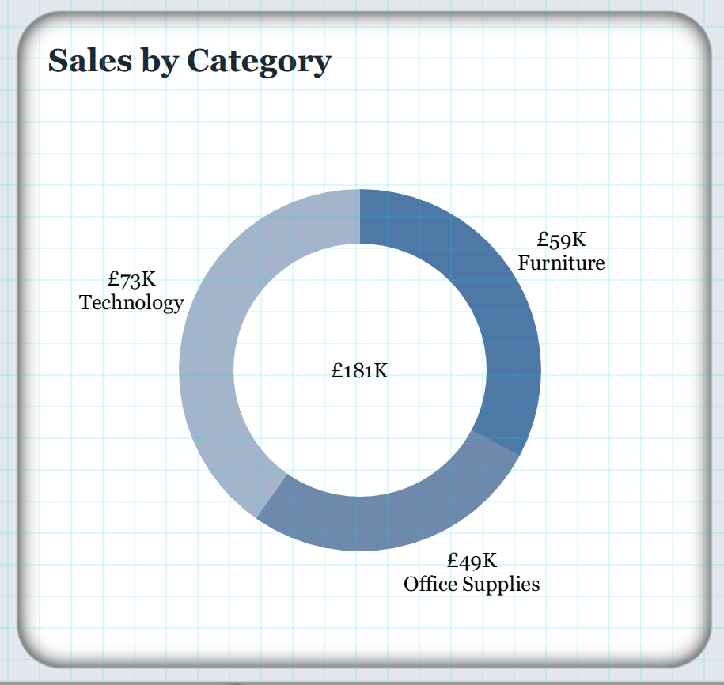
Sales by Category
Insight: Technology leads with £73K sales, while Furniture (£59K) lags in profit despite strong sales.
Recommendation: Boost Furniture profitability by reducing costs or revising pricing; expand Technology offerings.

Slide 5
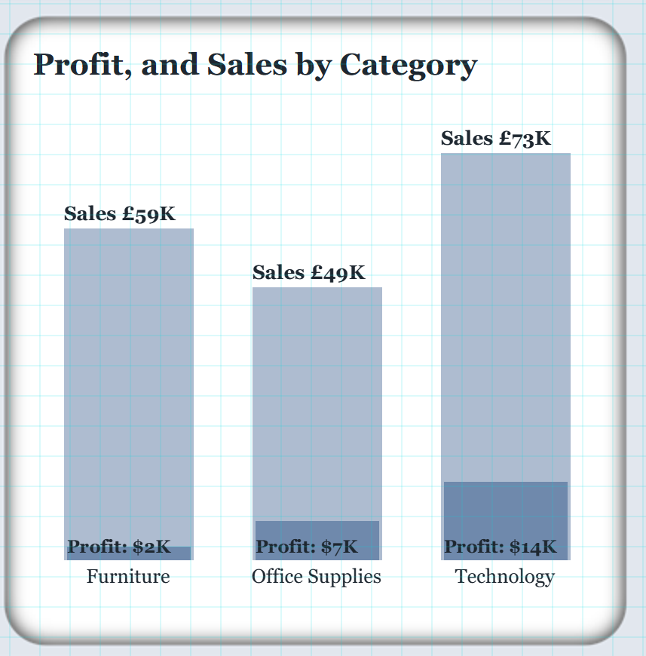
Profit and Sales by Category
Insight: Furniture generates only $2K profit despite £59K sales. Technology drives highest profit ($14K).
Recommendation: Renegotiate supplier costs for Furniture; prioritize Technology marketing to leverage high returns.

Slide 6
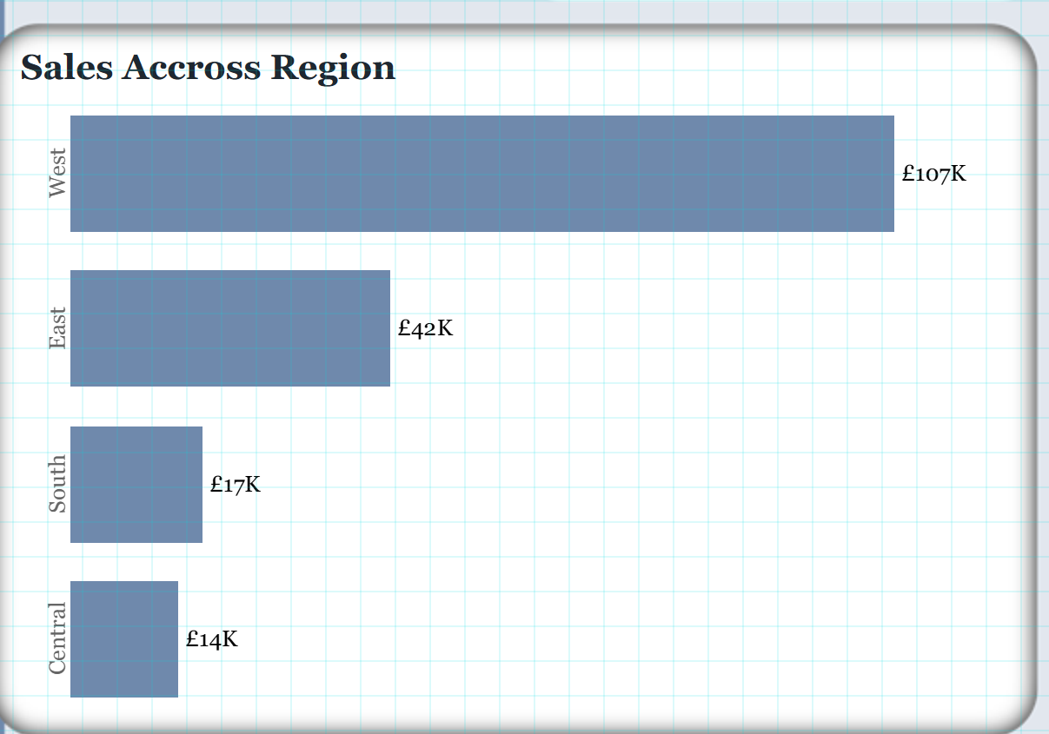
Sales Across Regions
Insight: West dominates (£107K), East follows (£42K), while South (£17K) and Central (£14K) underperform.
Recommendation: Expand promotions and marketing efforts in South and Central regions.

Slide 7
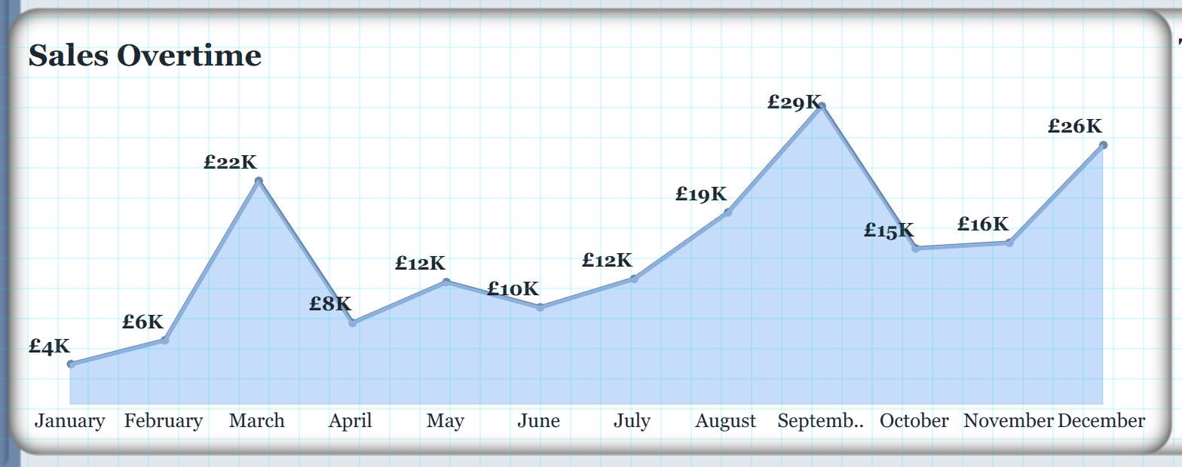
Sales Over Time
Insight: Peaks observed in March (£22K) and September (£29K). Sales dip significantly April–June.
Recommendation: Introduce seasonal promotions and discounts during slower months to stabilize revenue.

Slide 8
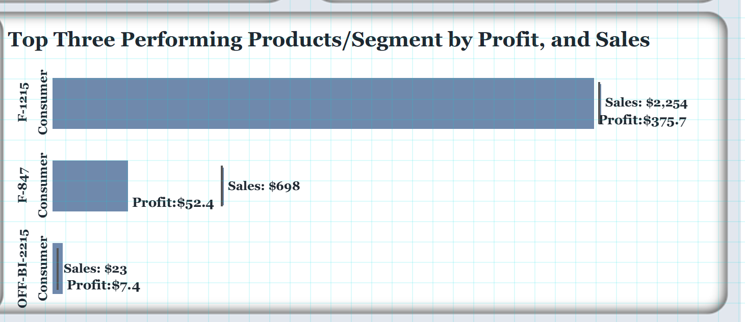
Top Performing Products
Insight: Product F-1215 (Consumer) dominates with $2,254 sales and $375 profit. Others contribute less.
Recommendation: Increase stock of F-1215; explore cross-selling strategies to boost underperforming products.

Slide 9

Conclusion & Next Steps
Key Insights Recap:
• Technology drives the highest sales and profit.
• Furniture underperforms in profit despite strong sales.
• West region is the top-performing region; South & Central need focus.
• Sales show seasonal peaks in March and September.
• Product F-1215 (Consumer) dominates product performance.
Next Steps: Optimize underperforming categories and regions, leverage seasonal trends, and invest in top-performing products.

